Slide 1
Optum Rx Talent Transformation

Slide 2
Talent Transformation – 3 Pillars
PEOPLE
Current Vs Future Competency Maps
Investment in Agile Coach & Scrum Coaches
Hire, Retrain and Retain ‘Right’ Talent
Develop new roles like PO, Focused Learning Maps
TECHNOLOGY
PROCESS
Investment in Tools Stack
Collaboration with Technology labs
Prototype, White Papers encouragement
OSAM Implementation
Investment in Process champions
Hiring process tuned to recruit Agile/DevOps & QEs

Slide 3
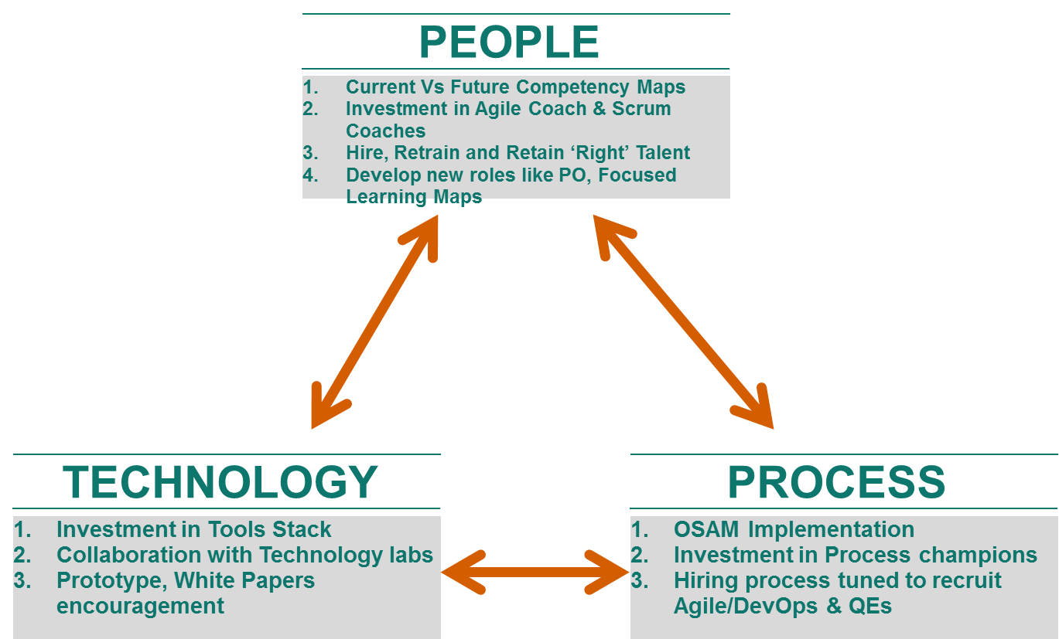
People Pillar
Approach
FINALIZE Targeted ROLE* towards ENGINEERING ORGANIZATION
Transform (to) Role ( Engineering Managers, Product Owner, QE, Scrum Master……)
2. Assessment – Where are our strengths, SKILL GAPS w.r.t targeted role(S)
People: Assessment of our current staff w.r.t. skills, experience- Grade-wise & for each role
3. POSSIBLE MAPPING w.r.t Expected Roles
Identify Close Match (FM judgement). Engineering Role available & Skill missing
4. Build COMPETENCY
Training, Hiring, Re-skill.
Success Criterion: Outcome based - ‘Targeted available role is filled’ & overall Competency enrichment
[* Please see addendum slides for Engineering Organization roles]

Slide 4
Technology Pillar
Approach
ABC
PQR
2. ABC
PQR
3. ABC
PQR
4. ABC
PQR

Slide 5
Process Pillar
Approach
ABC
PQR
2. ABC
PQR
3. ABC
PQR
4. ABC
PQR

Slide 6
Delivery Transformation - Roadmap
Planning
First 30 days
15-30th Dec
1st-15th Jan
16th -30th Jan
1st-15th Feb
16th-28th Feb
1st-15th Marc
16th- 30th Mar
PEOPLE:
Skills & Center of Excellence
PROCESS:
OSAM & Kanban
TECHNOLOGY:
GOVERNANCE:
Project Planning & Control
COMMUNICATION
Project Planning & Control

Slide 7
Engineering Organization: Targeted Roles & their responsibilities
Matt Mosher

Slide 8
Roles and Responsibilities – Team Level
Current Role | Hybrid CoE Role | Hybrid CoE Role Description
Dev/ QA/ Automation Tester | Engineer | Programmers, SA, QA and automation testers within a team should have the ability to design/ build/ test a full vertical slice of a user story (including automated unit and functional/acceptance test). The QA testers will transform to QE in our Agile Transformation Journey. Team is responsible for the deliverables.
Team Lead/ Dev Lead/ QA Lead/ SA Lead | Tech Lead | One of the senior team members who is well versed with engineering culture can be identified as Tech Lead with the Team Members reporting into this role. Tech Lead spends 80% of time on engineering activities and 20% on people management. Tech Leads are built into the structure to have proper succession planning and leadership development. Tech Lead is accountable for the delivery outcome.
Business Analyst/ UAT Tester | Product Owner | Product Owner (PO) is responsible for maintaining, prioritizing, grooming team backlog and clarifying questions and accepting user stories. PO may be shared by more than one team.
Project Manager/ SCRUM Master | SCRUM Master | SCRUM Master (SM) helps implementing agile practices and resolves impediments. SM ensures that the team is fully functional and productive. They facilitate the daily SCRUM, Sprint Planning, Sprint Reviews and Retrospectives. SM may be shared by more than one team.
Project Manager | Project Manager | For current Waterfall projects rolling into Hybrid CoE, the Project Manager role will continue to provide leadership to the project.

Slide 9
Roles and Responsibilities – Program Level
Current Role | Hybrid CoE Role | Hybrid CoE Role Description
Release Manager / Project Manager | Release Train Engineer (RTE) | RTE acts as a neutral entity to coordinate the releases across various Teams. RTE is the chief SCRUM Master, working at the program level to remove impediments, manage risks, and drive improvement. This role facilitates program-level events such as PI planning, inspect-and-adapt workshops, and the SCRUM of SCRUMS.
Business Owners | Product Manager | The Product Manager is responsible for the overall product vision and roadmap. This role works with Product Owners to ensure that features are delivered through releases to meet that vision. The Product Manager is responsible for the program backlog.
Business Sponsors | Business Sponsors | Set of stakeholders who has the shared responsibility on governance, efficacy and ROI at the program level. They are the sponsors and accepting the results at a program level
Delivery Lead / Project Manager / Program Manager | Delivery Lead | Delivery lead is responsible for multiple Teams within the Hybrid CoE for engineering delivery and people management. Delivery lead helps in further collaboration and coordination with integrated systems team (backend system) and external parties (vendors). This role will be responsible for PPM time allocation, Product release and overall Delivery.
Delivery Manager | Delivery Manager (Optional) | Delivery Manager is an optional role which may be required for extremely large portfolios which may require multiple Delivery Leads who in turn report onto to the Delivery Lead.
UI/UX (Optional) | UI/UX (Optional) | In order to provide a consistent User Experience (UX) across components and systems of the large solution, one or more User Experience designers is typically dedicated to the program level.

Slide 10
Roles and Responsibilities –Program Level contd.
Current Role | Hybrid CoE Role | Hybrid CoE Role Description
System Architect | System Architect | Responsible for the overall system architecture of a program/ project, making sure it solves stated business goals and objectives while being aligned with the strategy identified in the applicable reference, target, and transition architectures. Acts as a lead architect directing, integrating, and facilitating the work of required specialty architects and system analysts.
System Testing Team | System Team (Optional) | Responsibilities include Building Development Infrastructure, System Integration, End to End and Solution Performance Testing, System and Solution Demos. They do all the support in releasing the solution to the targeted environment by closely working with the DevOps team. Seniors QA folks, System architect/engineer are usually part of this team.
CI / CD Team / Deployment Team | DevOps (Optional) | Consists of system administrators, DBAs, operational engineers, network and storage engineers, and others responsible for deploying the solution. Creating the deployment pipeline by Building and maintaining staging environment, test environments, deployment to staging and production, version control, creating automatic build environment and automating the actual deployment process.

Slide 11
Roles and Responsibilities – Portfolio Level
Current Role | Hybrid CoE Role | Hybrid CoE Role Description
Portfolio Lead/ Delivery Director | Portfolio Lead/ Delivery Director | Portfolio Lead/ Delivery Director is the overall Hybrid CoE Leader who manages the Portfolio level Delivery. They will have Delivery Managers/ Delivery Leads reporting to them to manage the entire portfolio.
Enterprise Architect | Enterprise Architect | Enterprise Architects are responsible for the optimization of manual and automated processes into an integrated environment. They act as lead architects directing, integrating and facilitating the work of specialized architects while working on the target/ transition architecture.
PMO, Project Sponsor, Sr. Management | Program Portfolio Management | A group of individuals who are primarily responsible for strategy, investment funding, Program management and governance of the Portfolio.

Slide 12
Thank You
Matt Mosher

Slide 13
Potential Mapping for Cross Functional Roles
The cross-functional roles like PM, BA and QA will be de-centralized and can transition to new Hybrid CoE Roles based on their skill set, relevant experience, interest and requisite training.
Current Role | Current Responsibilities | Potential Mapping and transition to Hybrid CoE Role
Project Manager | Project Manager has the overall responsibility for the successful initiation, planning, design, execution, monitoring, controlling and closure of a project. Managing the project within the triple constraints of scope, time and cost. Resource planning and management Risk Management, SLA management, Metrics tracking and Governance. | RTE SCRUM Master Delivery Lead Project Manager – Some Hybrid CoEs may still need a Project Manager based on the mode of project delivery
Business Analyst (BA) | BA understands the business change needs and assesses the business impact Performs Requirement Elicitation, Requirement Management and Communication to relevant stakeholders Involves in UAT to certify that the software meets the specified requirements | Product Owner SCRUM Master Quality Engineer
Quality Analyst (QA) | Understanding requirements, specifications and technical design. Creating test strategy, test plans and test cases Estimating, prioritizing, planning and executing functional and NFR tests. Logging Defects and ensuring closure. | (Quality) Engineer Product Owner SCRUM Master

Slide 14
Talent (People) Transformation – Enabled by Tech, Process and Culture
PEOPLE
Current Vs Future Competency Maps
Investment in Agile Coach & Scrum Coaches
Hire, Retrain and Retain ‘Right’ Talent
Develop new roles like PO, Focused Learning Maps
TECHNOLOGY
PROCESS
Investment in Tools Stack
Collaboration with Technology labs
Prototype, White Papers encouragement
OSAM Implementation
Investment in Process champions
Hiring process tuned to recruit Agile/DevOps & QEs
CULTURE
Agile & DevOps as way of life
Investment in Reusable components
Knowledge dissemination through Rx University

Slide 15
Approach
Identify key stakeholders from each function
Formulate core team. Team understands current state & draws roadmap to achieve targeted outcome – Future state
Future state – Org Structure, enhanced capability
Assessment of current capability, identify delta/gaps , plan and conduct training, required hiring & investment – Ensure Readiness – Draw quarter on quarter plan
Leverage Toll gate & Rx University platform
Governance and Alignment with
- Onshore & OGS

Slide 16
Current State
Current Organization
Current Competency
B
A
Current State
A

Slide 17
Team
S.No | Talent Transformation – Core team member | Reporting Manager | Rx Functional Manager
1
2
3
S.No | Agile | Reporting Manager | Rx Functional Manager
1
2
3
S.No | QA to QE | Reporting Manager | Rx Functional Manager
1
2
3
S.No | DevOps | Reporting Manager | Rx Functional Manager
1
2
3

Slide 18
Thank you.

